Slide 1
Big Data Technology Final Project
Student: Van Loc Nguyen – 610513
Instructor: Professor Mrudula Mukadam

Slide 2
Big Data Technology – Objective
The main objective of this personal project is to demonstrate Spark Streaming feature using Spark Streaming api. The Source data is static stock and crypto data, the data is read from csv files and streaming thru a Kafka server. On the other side of the stream, the is Consumer using Spark Stream api to handle and store data into Hadoop HDFS. And finally, Spark-sql using Hive to demonstrate some simple queries.

Slide 3
Big Data Technology – Design
The project is constructed in 3 parts:
Producer: Play the role of data sink and send to Kafka topics
Consumer: Spark-Streaming API to listen data from Kafka topics and send to Hadoop’s HDFS
- Spark SQL: Using Hive-QL to demonstrate simple queries base on receiving data.

Slide 4
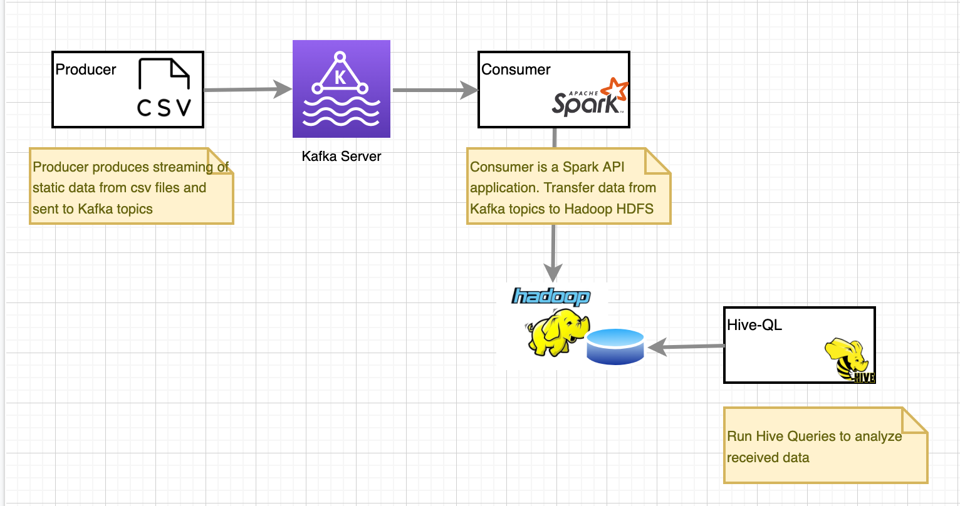
Big Data Technology – Design (Cont.…)

Slide 5
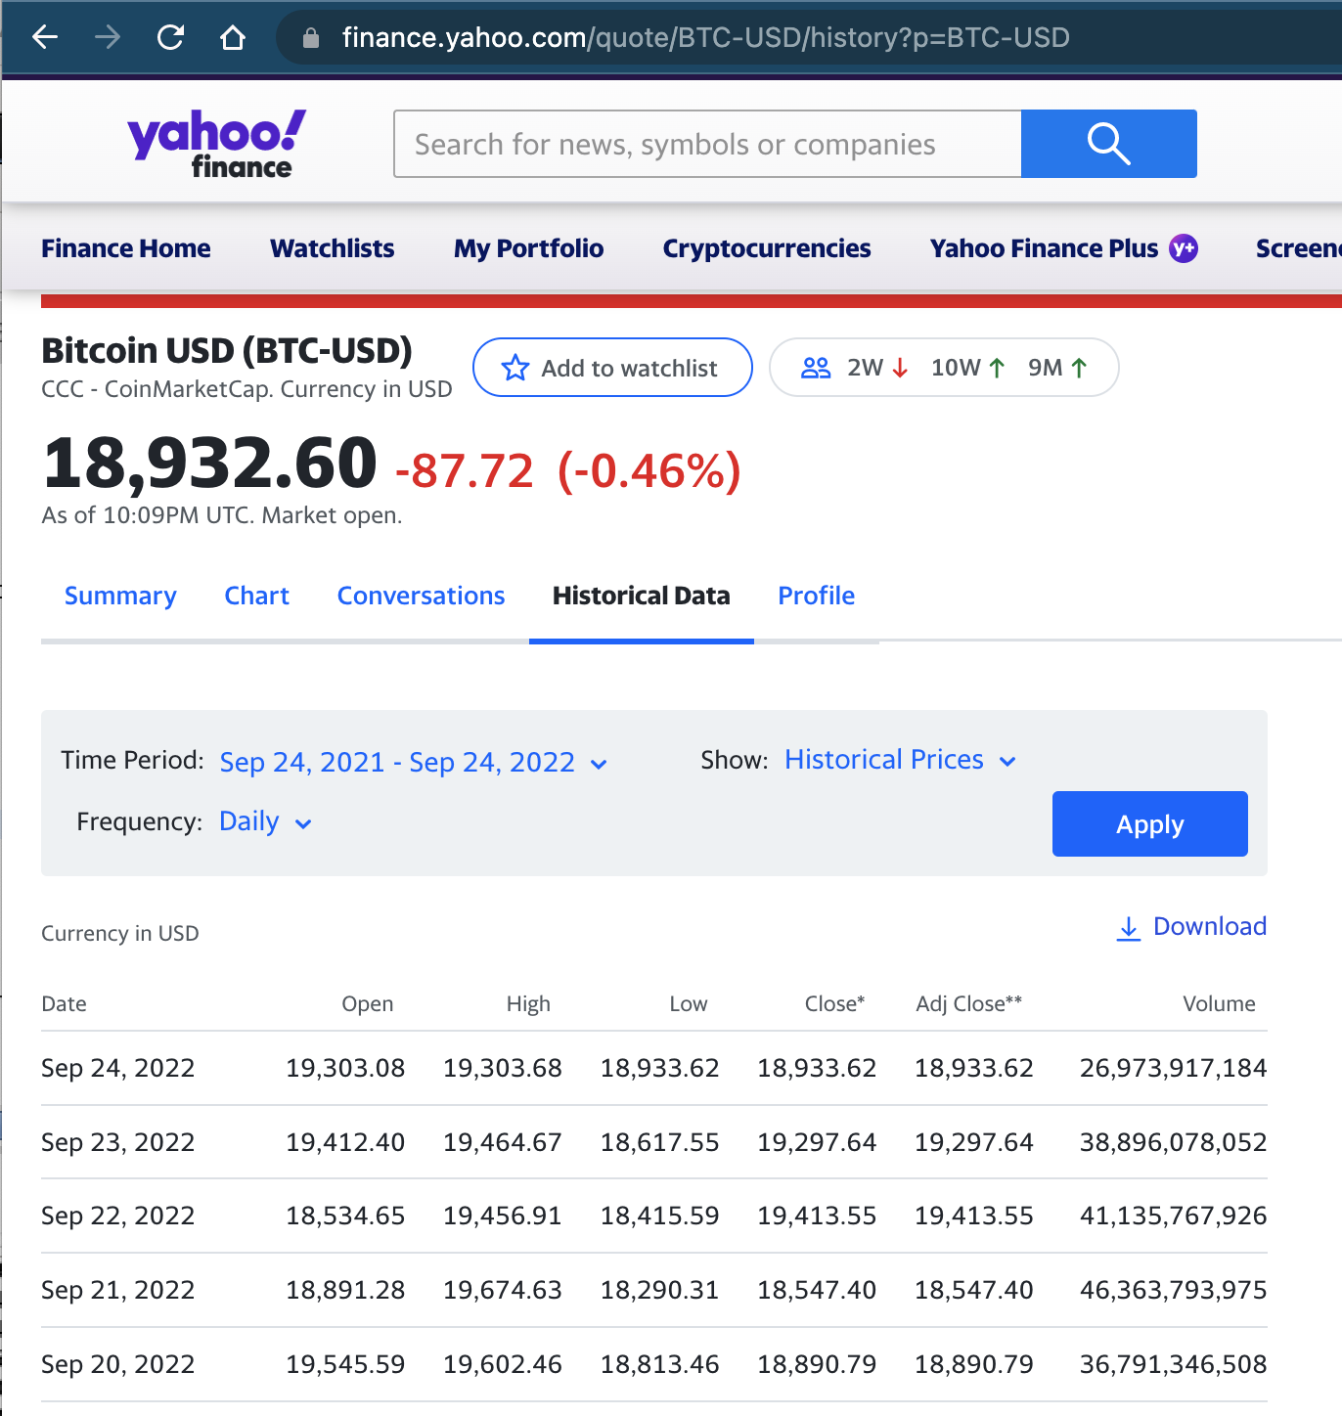
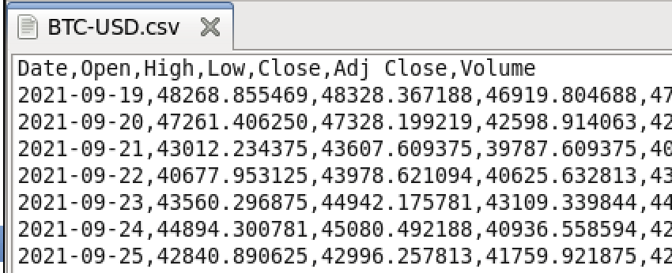
Big Data Technology – Data
The data I use in this demonstration is the real historical data which is collected from Yahoo Finance
For the demonstration purpose, I download just a small amount of data into a csv format

Slide 6
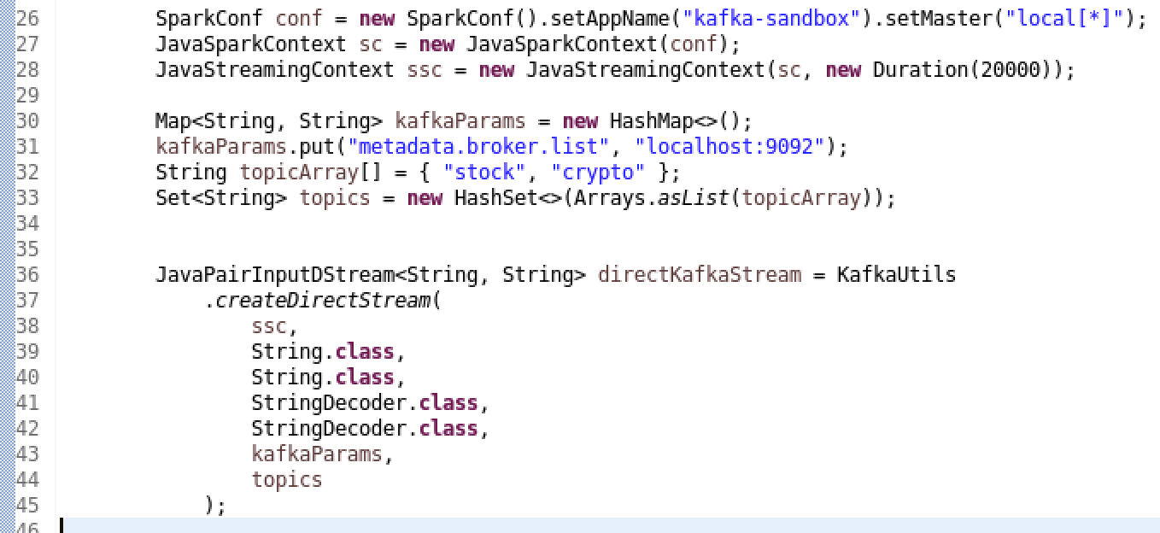
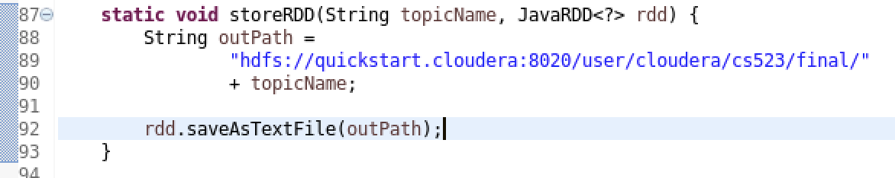
Big Data Technology – Implementation

Slide 7
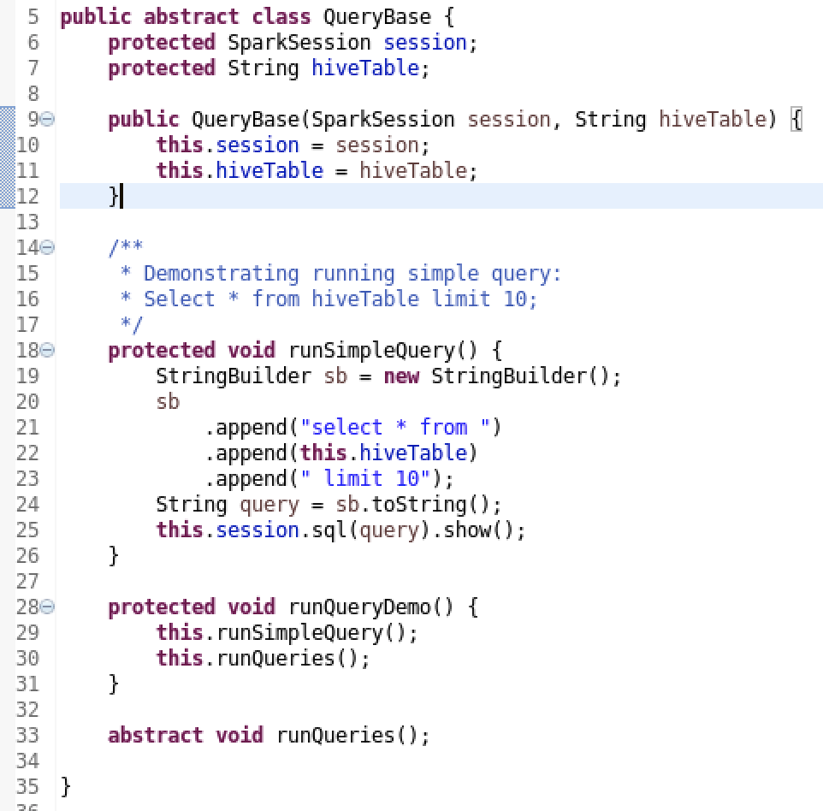

Big Data Technology – Implementation

Slide 8

Big Data Technology
Thank you!

